Slide 1






SCHOOL OF EXCELLENCE
Filling the gap between education
and the employment potential.
“Empower a Girl,
Empower a Generation.”
www.saisevasangh.org

Slide 2


Empowering 200 Beneficiaries Annually at Zero Fees
4-year program with professional Training.
Career Debut, By the age of 18 Years.
Opportunities to pursue either higher education or entrepreneurship
independently.
Skill training Begins at
14 Years.

Slide 3
Skill Programs
01
02
03
04
Digital Marketing
Animation
Performing Arts
Nutrition
Web development & Social Media Literacy
Photography, Audio-Video Editing& Graphic designing.
Classical Vocal, Instrumental Music &
Classical Dance.
Dietetics & Yoga

Slide 4

AI Driven Diploma in Digital Marketing for 50 Students
Digital Marketing Skill Set
Course Fee In Market
Web Development, SEO, AdWords, Affiliate Marketing, Social Media Marketing, Basic Photo & Video Editing.
Course Fee In Market : 1,00,000
But offering at Zero Fee.
Course Duration
Career Opportunities
4 Years 2 Years Class Room Training 1 Year live projects
1 Year Internship.
Corporate Companies, Digital Marketing Agencies,
E-Commerce & Start-ups, Media, Advertising & Creative Firms, Freelancing & Remote Work, Entrepreneurship.
Partners
Hamstech Academy,
CG Creed Academy.
Placement Assurance for every Student - 2 to 3 Lakhs Per Annum

Slide 5

AI Driven Diploma in Animation for 50 Students
Animation Skill Set
Course Fee In Market
Graphic Designing, VFX, 3D modeling, Photo and Video Editing.
Course Fee In Market : 1,50,000
But offering at Zero Fee.
Career Opportunities
Course Duration
Media & Entertainment Companies, Advertising & Creative Agencies, Digital Marketing & IT Companies, Educational Institutions & E-Learning Platforms, Production Studios & Freelancing, Entrepreneurship.
4 Years 3 Years Class Room Training 6 Months Internship
6 Months Industrial Training Program.
Partners
CG Creed, HAMSTECH, JNAFAU
Placement Assurance for every Student - 3 to 5 Lakhs Per Annum

Slide 6

Diploma in Performing Arts for 50 Students
Performing Arts Skill Set
Course Fee In Market
Bharatanatyam, Carnatic Music, Make UP & Costume Designing and Musical Instruments.
Course Fee In Market : 2,50,000
But offering at Zero Fee.
Course Duration
Career Opportunities
4 Years 4 Years Class Room Training Stage Performances
Cultural academies International Schools As Dance & Music Teachers, film and TV industry, event management companies, recording studios, theatre groups, Eligible for Bachelor of Performing Arts(BPA).
Partners
Varna Arts Academy, Bridge Academy, Tyagaraja Music College.
Placement Assurance for every Student - 5 to 6 Lakhs Per Annum

Slide 7

Diploma in Nutrition & Dietetics for 50 Students
Nutrition Skill Set
Course Fee In Market
Understanding human physiology, disease and Diet Menu Planning. Cooking and serving, Primary Health Care.
Course Fee In Market : 2,00,000
But offering at Zero Fee.
Course Duration
Career Opportunities
4 Years 3 Years Class Room Training 1 Year Internship.
Health & wellness centers, fitness studios, hospitals, nutrition clinics, food & beverage companies, Oldage Homes and wellness resorts.
Partners
Nutriline ‑ The Wellness Centre,
NIN (National Institute of Nutrition),
Home Science College of HYD.
Placement Assurance for every Student - 3 to 4 Lakhs Per Annum

Slide 8




Mandatory modules for Holistic Development
Public Speaking, Presentation Skills & Behavioral Etiquette
Basic Skills provided for all the
4 programs
Artificial Intelligence
Introduction to Basic Accounts & Financial Management
Time Management &
Self-Discipline

Slide 9
Why Sai Seva Sangh has ventured into this space
Other Academies in the market
Criteria
School of Excellence
18+ years
Eligibility
14 years
Few months
Duration
4 Years Course
Online theory; 0- 6 hours or practicals per week
In person theory course; 36 hours of practical experience per week
Quality
Nil
Skill coverage
Holistic development including public speaking, financial literacy, AI basics, Time management.
Nil
Practical exposure
1 year mandatory corporate exposure
Orphan & under privileged girls from low income families
Upper middle class; co-education
Beneficiary
1 to 3 Lakhs
Fee
Totally free of cost
Limited commitment
Placement
Guaranteed placement in the range of 2-5 Lakhs

Slide 10









E-E-E
Nutrition
Support infra
Animation
Digital Marketing
“Educate, Empower & Enlightenment”
Performing Arts
The School of Excellence will be open not only to girls from Sai Seva Sangh but also for girl children from other orphanages and underprivileged backgrounds.
Let’s join hands and build together a future where every young woman can lead, create and inspire.

Slide 11
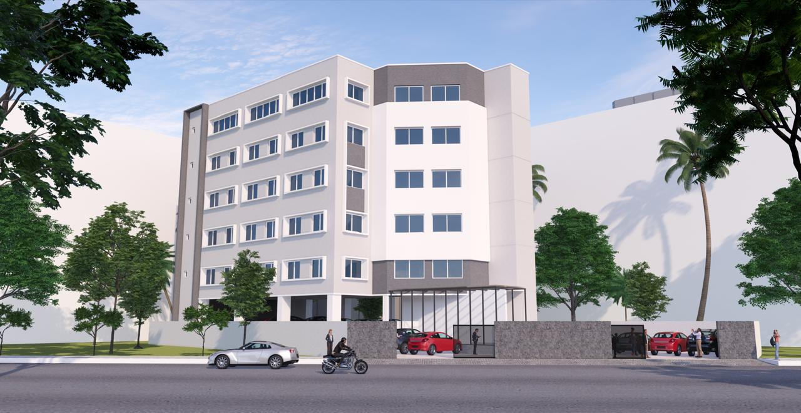

Slide 12


Thank you,
for your valuable time
We welcome you to visit us!
Website: Phone no | www.saisevasangh.org 9989928551 / 552
Email Id : Location: | info@saisevasangh.org saisevasangh99@gmail.com 5-240, 2, HP Road, Bhavani nagar, Moosapet, Hyderabad, Telangana-500018

